Slide 1
Social Media Strategies: Best Business and Litigation Practices
Notes:
Introduce ourselves, our practice and our experience/perspective on social media

Slide 2
Overview
The Prevalence of Social Media
Critical Business Issues
Employment
Litigation
How Far Should You Go?
Company Guidelines
Notes:
Sandra

Slide 4
Infiltration of Social Media
Critical to business today
1 billion Facebook users
650+ social media cases since 2010-2012
75% of employees access social media from personal mobile devices at work
“We don’t have a choice on whether we DO social media. The question is how well we do it.”
Notes:
Christy

Slide 5
Leading Social Media Sites
Notes:
Kacy – some examples of how social media is critical to business

Slide 6
Social Media Business Issues
False Advertising – Performance Claims & Reviews
Employment Law
Product Liability
Regulatory Challenges (FTC & FDA)
Intellectual Property (copyright, privacy tort, trademark infringement)
Confidential Information
Disclosure of Material Connections
Notes:
Kacy

Slide 7
Social Media from 30,000 Ft.
“Social media jurisprudence” revolves around four fundamental values that cut across all industry sectors and substantive disciplines:
Transparency (disclosing “material connections”)
Accuracy (communicating truthful information)
Honesty (avoiding misleading or deceptive communication)
Respect (recognizing personal or property rights of others)
Notes:
Kacy

Slide 8
Marketing Challenges
Regulatory requirements govern product labeling, advertising, and promotions
Social media presents unique challenges
interactive nature of media and lack of control
global reach and infinite life of postings
Challenges increase for regulated industries
adverse event reporting requirements
monitoring for off-label uses/misuses
Notes:
Kacy

Slide 9
Notes:
Paul: Intro to Employment

Slide 10
Employment Law Implications
How Social Media is Relevant to Employment Law
Proactive employee use
Brand Ambassador
Property Issues
Employee misuse
Notes:
Paul/Sandra
How do discover employee misconduct?
Pitfalls associated with disciplining employees for social media use?
Brand ambassador: should companies restrict or encourage employee use? If so, which guidelines should be in place? If so, what are the implications?
Company property: phone dog media

Slide 11
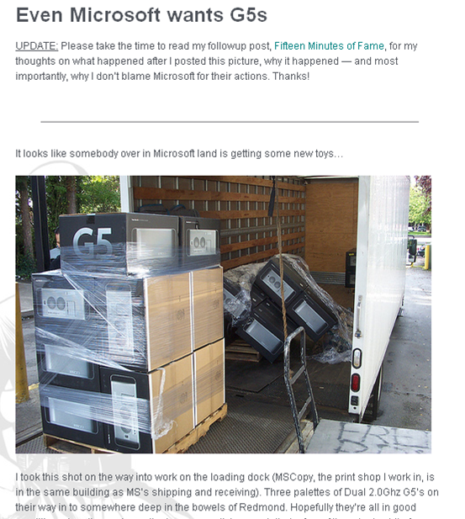
What You Do Can Be Held Against You
Microsoft employee terminated after posting a picture he took of Apple computers being delivered to Microsoft’s headquarters

Slide 12
Twitter Gets You Fired in 140 Characters or Less
A tweet by “theconnor”:
“Cisco just offered me a job! Now I have to weigh the utility of a fatty paycheck against the daily commute to San Jose and hating the work.”
And an immediate retweet by Cisco:
"Who is the hiring manager. I’m sure they would love to know that you will hate the work. We here at Cisco are versed in the web."
Notes:
Paul/Sandra

Slide 13
Employment Law Implications
Monitoring Employee Use
Concerted Activity
Notes:
Paul/Sandra
Pros/cons of monitoring employee use
Sandra – can you add an image to make this slide a little more exciting?

Slide 14
Litigation
Source of litigation
Tool in litigation
Pitfalls in litigation
Notes:
Kacy – examples of SM as source of litigation
Christy – examples of SM as a tool (investigative)
examples of the pitfalls (ethical obligations to abide by)

Slide 15
Litigation Tools
Investigate substantive allegations
Identify and research witnesses
Contradict damages claims
Prove failure to mitigate/other income sources
Notes:
Christy: Paul/Sandra add employment examples

Slide 16
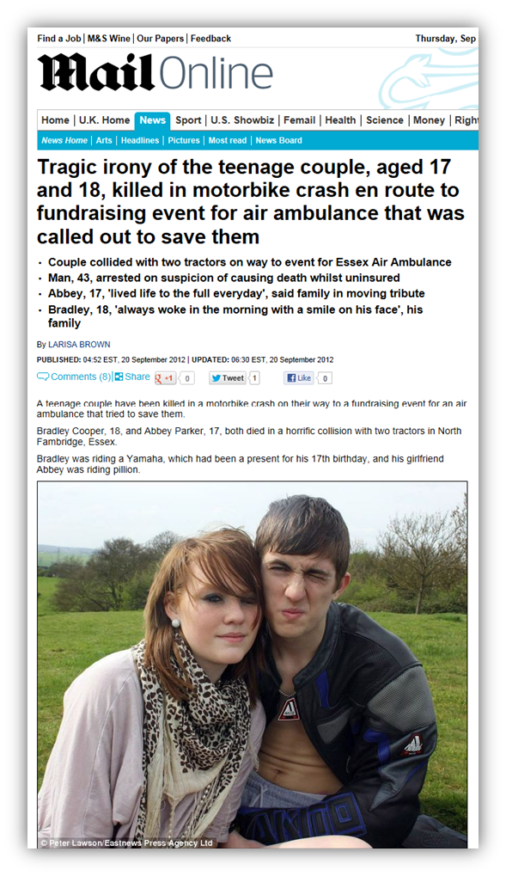
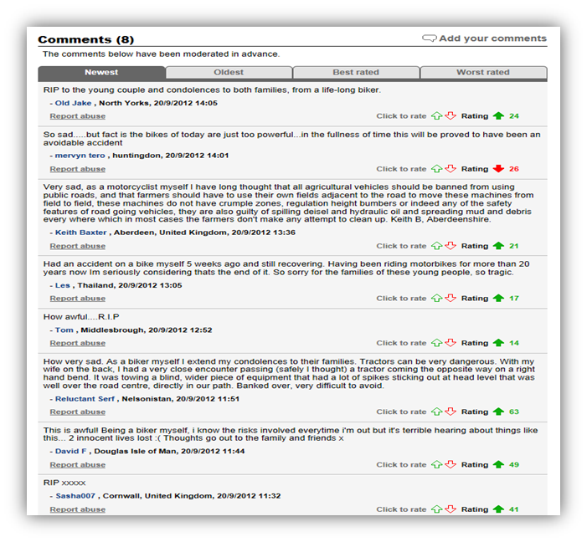
Notes:
Christy

Slide 17
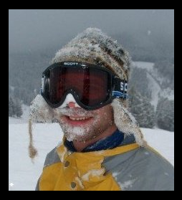
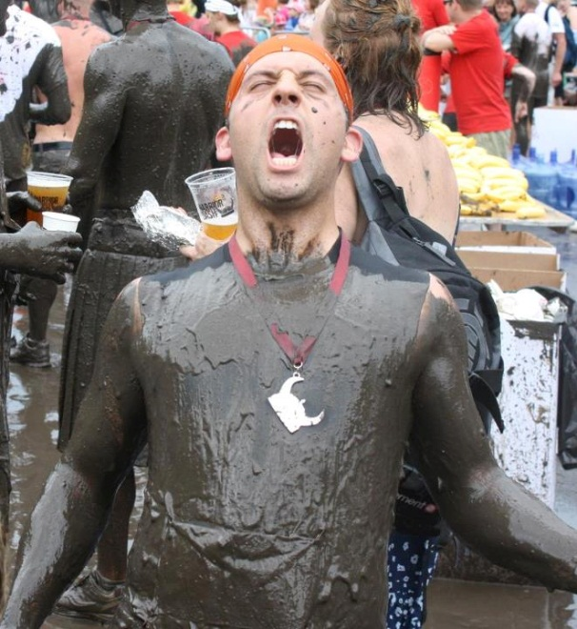
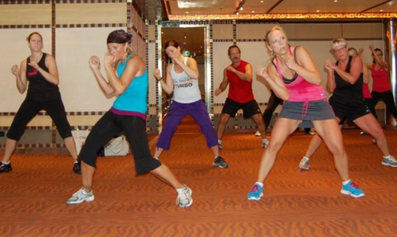
Notes:
Christy/everyone

Slide 18
Notes:
Kacy/product demos and competitors

Slide 19
Discovery
Don’t limit search to Google and Facebook
Don’t spoliate evidence
Don’t forget to authenticate
Don’t attempt access to irrelevant information
2012 Court Decisions
Notes:
Christy/everyone
Examples of other useful websites: Wayback, Google Images, Twitter (growing trend esp among teenagers); Usernamechk; don’t overlook blogs – have to do separate search. Location tracking (“checking in” on Facebook; “tweet your location” –coordinates to your location at time of post
Authenticate:
If plaintiff’s profile is public → Electronic capture of the content and photos + Affidavit or testimony of the person who captured the website, with URL, the date the content was printed, the method of printing and confirmation the copy is accurate.
If private profile → self-authentication: Download Your Information; request usernames
2012:
Tompkins v. Detroit Metropolitan Airport (E.D. Michigan Jan. 18, 2012)
Must be some showing of relevance before the Court will compel full production of plaintiff’s Facebook account
Here, failed to meet threshold showing.
Slip and fall accident: photographs of her playing golf or riding horseback = full access to private Facebook pages.
Loporcaro v. City of New York and Perfetto Contracting Co., 35 Misc.3d 1209 (N.Y. Sup. Ct. Apr. 9, 2012):
Permanent disability claim contradicted by public Facebook postings showing active lifestyle prompts Court to compel production of full Facebook profile.
“When a person creates a Facebook account he may have consented to the possibility that personal information might be shared with others, notwithstanding his privacy settings.”

Slide 20
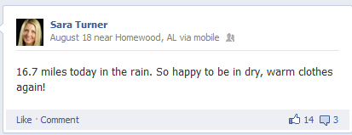
Notes:
Christy/everyone

Slide 21
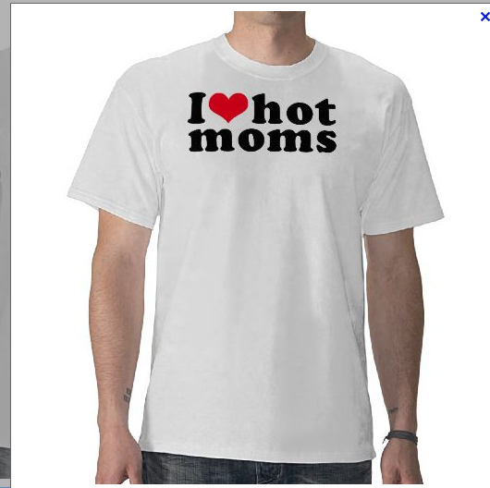
October 2011 Spoliation Sanctions
Lester v. Allied Concrete
Matthew Murray
$542K
Obedient Client
$180K
Notes:
Christy/everyone
Attorney instructed plaintiff in wrongful death case to clean up FB page. Later atty told him to deactive his account so he could prepare written discovery indicating he had no active account as of the date the discovery was signed.
Lesson: You can’t and plaintiff’s counsel can’t obstruct defendant’s access to evidence or alter, destroy or conceal documents with potential evidentiary value

Slide 22
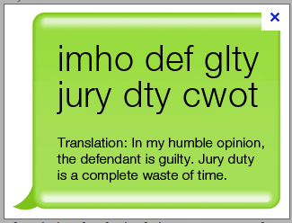
Trial
Jury
Witnesses
Opposing Counsel
And yes, even the Judge
Notes:
Christy; Kacy to give mock jury examples
Juror misconduct – growing issue. Caused many mistrials, massive amounts of $
Extremely important to investigate jurors before voir dire –can gather information helpful to choosing a jury and more importantly can make sure a juror who has drastic beliefs (i.e. hates your corporate client and had a bad experience with them they’ve been discussing on the Internet) never gets an opportunity to voice those opinions in front of your jury. Don’t want your jury poisoned.
Brand new model jury instruction – should be using in every case:
You may not communicate with anyone about the case on your cellphone, through email, BlackBerry, iPhone, text messaging, or on Twitter, through any blog or website, including Facebook, Google+, MySpace, LinkedIn or YouTube … I expect you will inform me as soon as you become aware of another juror's violation of these instructions.“
Make sure your judge is following the rules:
Texas judge requires juveniles to friend her; watches for illegal activities and then schedules compliance hearings
North Carolina judge publicly reprimanded for ex parte communications with attorney
Georgia judge resigned after Facebook documented his relationship with defendant
Florida judge exchange 9.35 communications/day over 5 months with prosecutor during capital murder case

Slide 23
Use of Social Media: How Far Should You Go?
Public v. private
Context is key
Company reputation
How much do you really want to know?
Notes:
Sandra/everyone
How much do you really to know? – protected class implications?
CMM: If private, but have a reason to suspect plaintiff is lying about injuries, use written discovery/deposition to get at additional information.
Think about what you are comfortable having a jury know you/your client did – don’t want to overreach; need to find balance between being treated fairly (shouldn’t have to deal with inflated injury claims) and going too far to secure access to private information
Context is key: P might be a scumbag; need to communicate with client; case by case basis

Slide 24
Ethical Issues
Ethical Prohibitions?
Ethical Obligation?
Griffin v. Maryland, 192 Md. App. 518 (2010):
“it should now be a matter of professional competence for attorneys to take the time to investigate social networking sites”
Competence
Diligence
Notes:
Prohibitions: Christy – friending, LInkedIn; Sandra changing geographic region
Obligations?: Kacy/Paul from in-house perspective
Discussion questions:
How much should attorneys be doing?
Is it a given that SM should be considered in every case?
Should outside counsel be asking permission before exploring SM considerations?
Does it depend on the type of case it is?

Slide 25
Social Media Company Policies – (1) General Principles
Do not disclose confidential information.
This includes IP, financial, pricing, strategic, personnel and customer information.
Do not comment on company financial or operational information.
Follow company policies such as copy approval process and brand identity standards
Ensure that all claims are accurate and substantiated
Notes:
Kacy/everyone

Slide 26
Social Media Company Policies – (1) General Principles - cont.
Do not copy and post materials of others (like photos, articles, music, logos, trademarks) without ensuring you have permission to do so.
To avoid copyright infringement, use links instead.
Avoid deep links and links using graphics which might be trademarked.
Releases for Use
Do not mention customer names or customer information without their prior written permission.
Be professional and use a respectful tone.
Notes:
Kacy/everyone

Slide 27
(2) Company-Initiated Social Media Sites
Before initiating site, must coordinate with appropriate resources, e.g. PR, Corporate Communications and/or Legal.
Designated company representatives should receive social media training.
Develop Site Terms and Conditions
Follow company policies such as copy approval process and Brand Identity standards.
Monitor and Respond
Notes:
Kacy/everyone

Slide 28
(3) Guidelines for Third-Party Social Media Site
Any spokesperson appointed to contribute to the social media community on behalf of company should receive social media training.
Write under your own name or a corporate screen name. Disclose your identity as an employee.
Follow company policies such as copy approval process and Brand Identity standards.
Know and follow the terms and conditions for use of the site. Some sites, e.g., prohibit product promotions.
United Breaks Guitars
Notes:
Kacy/everyone

